Slide 1

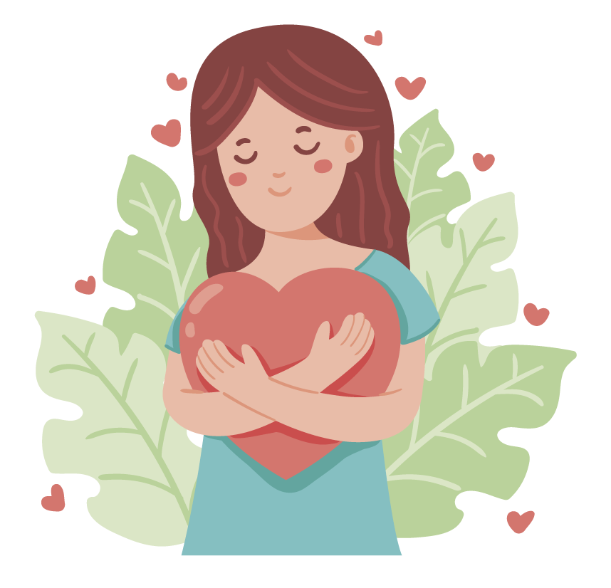

To Practice
Self Care
lausd.org/human-relations

Slide 2


Would You Rather
ide a horse
Ride an alligator
Ride a horse
lausd.org/human-relations

Slide 3
Self Care Is…
Making choices that help us feel better when we are upset or overwhelmed.
Self care is also choosing to do things that take care of your body, brain, and heart.
lausd.org/human-relations

Slide 4
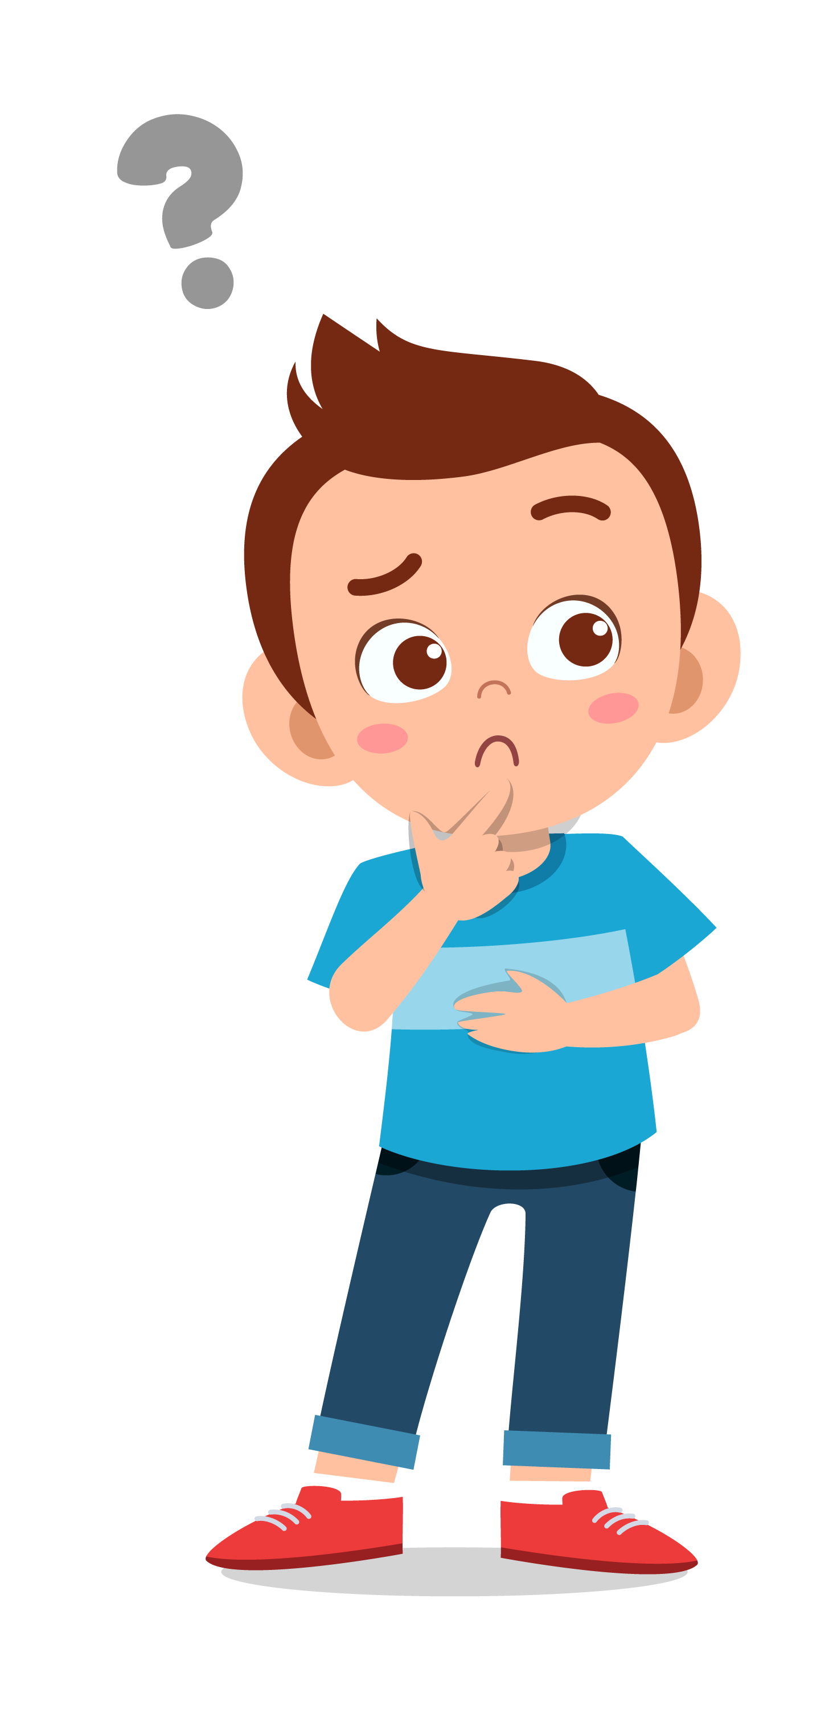


Pair Share
What are some ways folks might help themselves feel better when you are upset or overwhelmed?
Have you ever tried any of these?
lausd.org/human-relations

Slide 5
Importance Of Self Care
Choosing to do self-care helps:
our bodies and brains be calm,
us to pay better attention,
feel more happiness,
have more energy, and
feel less frustration and anger
lausd.org/human-relations

Slide 6

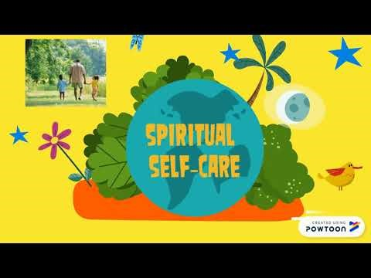
Why is Self Care Important?
lausd.org/human-relations
Notes:
https://www.youtube.com/watch?v=_X55radTB-M

Slide 7
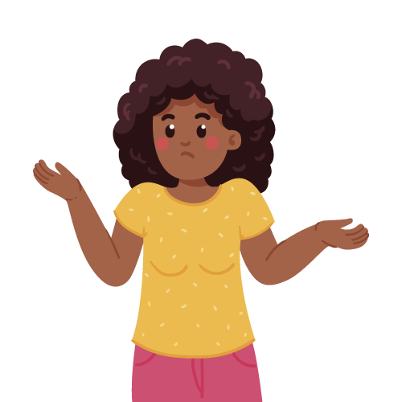

Pair Share
Practicing self-care is about making consistent choices to take care of yourself
Which one of the self-care tips from the video would you choose to try?
lausd.org/human-relations

Slide 8
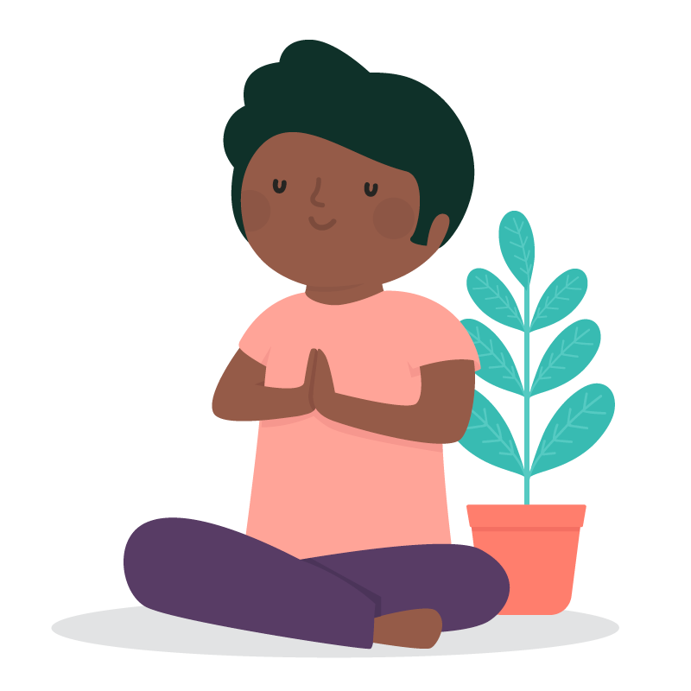
Types of Self Care
Basic
Everyday choices that help us stay well
Choices: brushing our teeth, taking a bath, eating
Emotional
Activities that help you feel comfortable, safe and calm.
Choices: journaling, doing art, practicing kindness or gratitude
lausd.org/human-relations

Slide 9
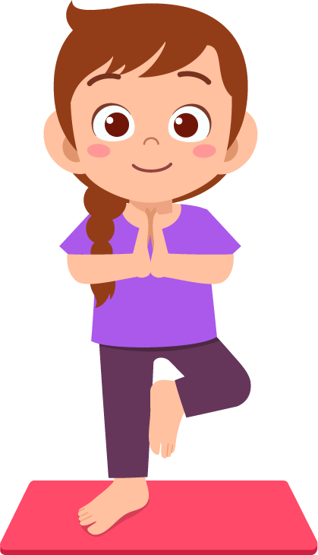
Types of Self Care
Physical
Activities that help our bodies stay healthy and well
Choices: exercising, drinking water, sleeping moving our body, deep breathing
Spiritual
Activities that help us to think about our part in the great big world
Choices: meditating, doing yoga, practicing a religion, spending time in nature
lausd.org/human-relations

Slide 10
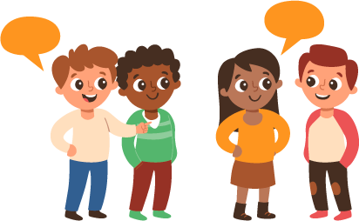
Types of Self Care
Social
Activities that help us feel connected to the people in our lives.
Choices: talking to friends or family, attending events that bring you joy, being mindful of our social media.
lausd.org/human-relations

Slide 11
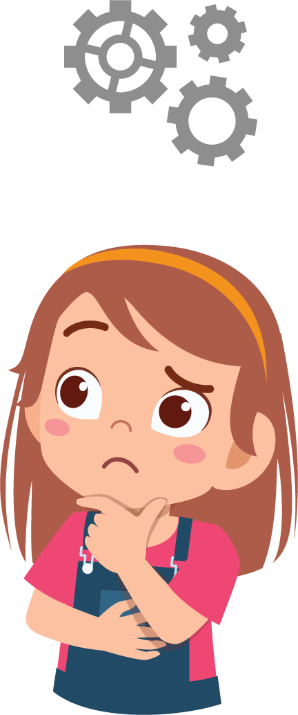

Pair Share
What types of self care do you already do?
What self care choices are you going to make moving forward?
lausd.org/human-relations

Slide 12
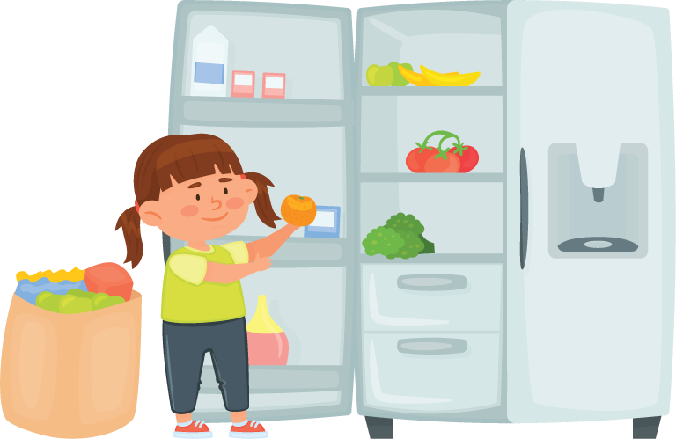
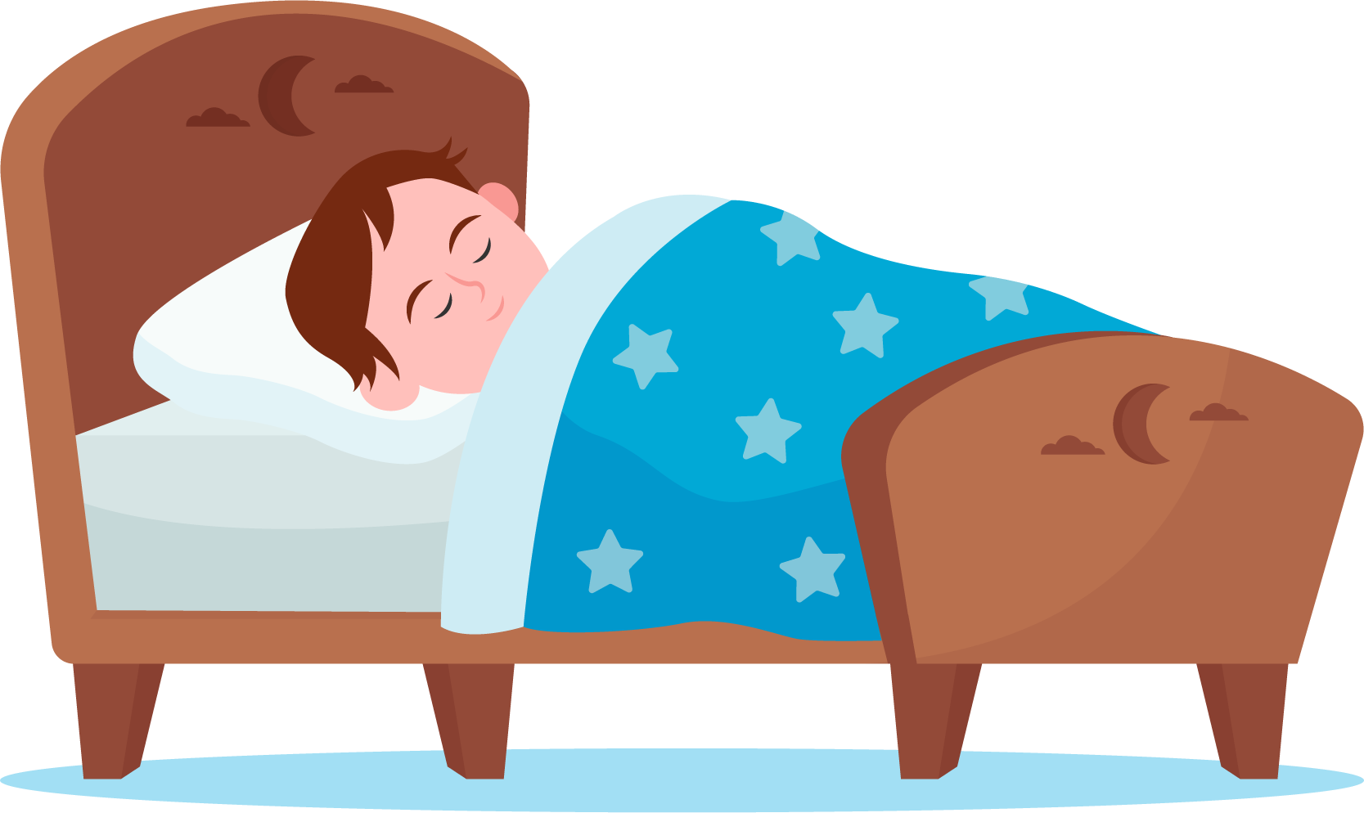
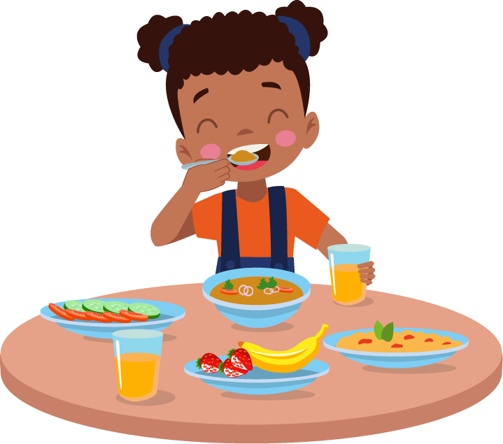
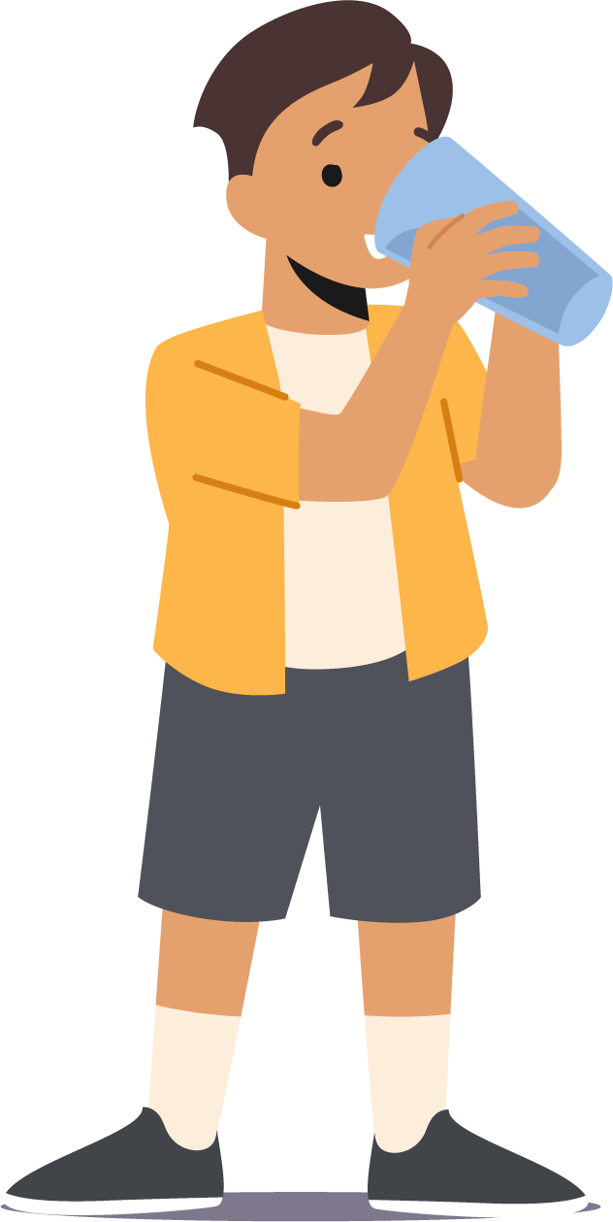
Check Out
Make a Choice Today!
Get Plenty of sleep
Try to Organize your time
Fuel your body
Keep hydrated
lausd.org/human-relations

Slide 13
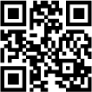
Committed to fostering a safe and respectful District, school and community culture where the seeds of peace and justice are down so that all students and staff can lead safe, purposeful and academically fruitful lives.
Connect with us at bit.ly/LAUSD-HRDE
lausd.org/human-relations

